Slide 1

Week9 Transport Layer
  COMP90007 Internet Technology
Prepared by: Chenyang Lu (Luke)

Slide 2
Your Tutor
Chenyang Lu (Luke)
- Email: chenyang.lu@unimelb.edu.au
- Workshop Slides: https://github.com/LuChenyang3842/Internet-technology-teaching-material
Day | Time | Location
Tue | 18:15 | Bouverie st –B114
Wed | 10:00 | Elec Engineering -122
Wed | 17:15 | Bouverie-sr 132

Slide 3
Transport Layer

Slide 4
Transport Layer
Application
Transport
Network
Data Link
Physical
  Question:
  1. what is the main function of transport layer?
  2. What are the two main protocols used in the transport layer?

Slide 5
Transport Layer
Application
Transport
Network
Data Link
Physical
  Main function:
  - Provide efficient, reliable & cost-effective data transmission service
  - Independent of physical or data networks
  Two Major protocol:
  TCP (Connection oriented) and UDP (Connetionless)

Slide 6
Transport Layer
  Transport Layer Encapsulation
  Transmission Control Protocol (TCP)
    Connection-establishment
      Three-way handshake
    Connection-release
      Asymmetric
      Symmetric
    TCP segment header
    TCP based socket
    Error-control
    Flow-control
    Congestion-control
      Slow start
      Additive increase
  User Datagram Protocol (UDP)
Application
Transport
Network
Data Link
Physical

Slide 7
Encapsulation
Transport Layer
TPDU Header
TPDU payload

Slide 8
Encapsulation
Transport Layer
TPDU Header
TPDU payload
Network Layer
Packet Header
TPDU Header
TPDU payload
Packet payload

Slide 9
Encapsulation
Transport Layer
TPDU Header
TPDU payload
Network Layer
Packet Header
TPDU Header
TPDU payload
Packet payload
Frame Header
Packet Header
TPDU Header
Datalink Layer
TPDU payload
Frame payload

Slide 10
Transport Layer
  Transport Layer Encapsulation
  Transmission Control Protocol (TCP)
    Connection-establishment
      Three-way handshake
    Connection-release
      Asymmetric
      Symmetric
    TCP segment header
    TCP based socket
    Error-control
    Flow-control
    Congestion-control
      Slow start
      Additive increase
  User Datagram Protocol (UDP)
Application
Transport
Network
Data Link
Physical

Slide 11
Connection Establishment
Connection oriented (TCP)
Start with connection request
Connection established by Three-way handshake

Slide 12
Connection Establishment
Connection oriented (TCP)
Start with connection request
Connection established by Three-way handshake
Client and server both have a timer, if time-out and no ack back for a certain data unit, send again to avoid lost of data unit
Use sequence number to avoid duplication and data out of order
Looks like easy and clean! But it is not, we need to do more thought experiment to fully understand three-way handshake
Client
Server
SYN seq = x
SYN-ACK ack =x seq =y
ACK ack =y seq = x+1

Slide 13
Connection Establishment
Client
Server
Question:
For the connections between two hosts,
Is the initial sequence number always the same?? Say, always start from 0?
SYN seq = x
SYN-ACK ack =x seq =y
ACK ack =y seq = x+1

Slide 14
Connection Establishment
Client
Server
Question:
For the connections between two hosts,
Is the initial sequence number always the same?? Say, always start from 0?
NO
- We should either store infinitely increasing sequence number or find another mechanism to refresh the sequence number safely!
SYN seq = x
SYN-ACK ack =x seq =y
ACK ack =y seq = x+1

Slide 15
Connection Establishment
--- (Maximum packet life time and sequence number refresh)
The hosts can not infinitely maintain a continuously growing sequence number,
we need a mechanism to refresh the sequence number table and discard the old sequence number.
To achieve this, we set packet lifetime to kill off old aged packet. So we can safely refresh the “sequence number table” stored in the hosts after a certain time interval
We should refresh the "sequence number table" stored in hosts only after the "maximum packet lifetime" that we choose.
The maximum packet lifetime should be large enough to ensure that not only the packet but also its acknowledgements have vanished
Refer to textbook 513
Client
Server
SYN seq = x
SYN-ACK ack =x seq =y
ACK ack =y seq = x+1

Slide 16
Connection Establishment
--- (Maximum packet life time and sequence number refresh)
Packet lifetime: Time to live of packet, information contained in packet
Maximum packet lifetime: The maximum packet lifetime that host believes. Information contained in host.

Slide 17
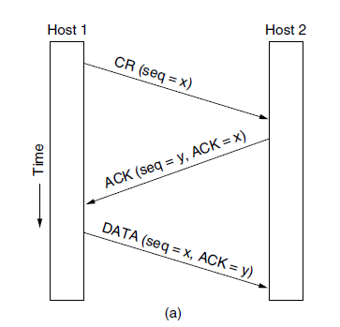
Three protocol scenarios using Three-way handshake
Under Normal Operation, connection established through 3-way handshake:
  Host 1 send Connection request to Host2 with initial sequence number x
  Host 2 response with ACK (confirming x), and declare its own initial sequence number y
  Last, Host 1 acknowledges host 2’s choice of an initial sequence number.

Slide 18
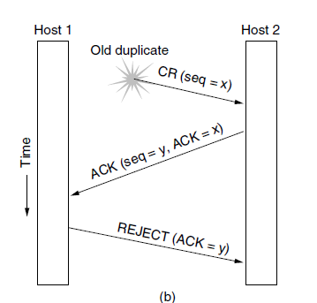
Three protocol scenarios using Three-way handshake
when delay happens:
  The first segment is a delayed duplicate CONNECTION REQUEST from an old connection. This segment arrives at host 2 without host1’s knowledge.
  Host2 React to this segment by sending host1 an ack segment. Asking for verification that host 1 was indeed trying to set up a new connection.
  Host1 reject host 2’s attempt to establish a connection.
In this way, a delayed duplicate does no damage.

Slide 19
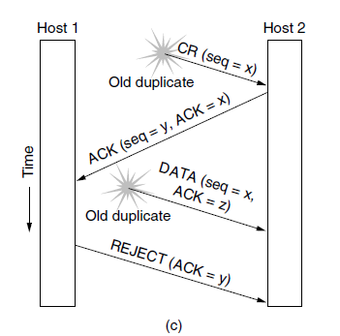
Three protocol scenarios using Three-way handshake
The worst case, Both delayed CONNECTION REQUESTI and an ACK are floating around in the network:
As in the previous example, host 2 gets a delayed connection request and replies to it.
At this point, it is crucial to realize that host2 has proposed using y as the initial sequence number for host 2 to host1 traffic, knowing full that no segments containing sequence number y or ack to y are still in in existence (Thanks for correctly choosing maximum packet lifetime!)
When the second delayed segment arrives at host 2, the fact that z has been acknowledged rather than y, tells host2 that this, too, is an old duplicate!
Still, nothing goes wrong!

Slide 20
Question 1 (Connection Establishment)
In determining maximum packet lifetime, we have to be careful and pick a large enough period to ensure that not only the packet but also its acknowledgements have vanished. Discuss why this is needed.

Slide 21
Recall the worst case, Both delayed CONNECTION REQUESTI and ACK are floating around in the network:
As in the previous example, host 2 gets a delayed connection request and replies to it.
At this point, it is crucial to realize that host2 has proposed using y as the initial sequence number for host 2 to host1 traffic, If we wrongly choose maximum packet lifetime, host2 thinks that no segments containing sequence number y or acknowledgements to y are still in existence
Unfortunately, due to the wrong choice of maximum packet lifetime, the old duplicate ack to y are actually still floating around and arrive at host2 before REJECT segment sent from host1 arrive host2.
Disaster happens!
y

Slide 22
Question 2 (Connection Establishment)
Imagine that a two-way handshake, rather than a three-way handshake were used to set up connections. In other words, the third message was not required. Are deadlocks now possible? Give an example or show that none exist.

Slide 23
Question 2 (Connection Establishment)
Imagine that a two-way handshake, rather than a three-way handshake were used to set up connections. In other words, the third message was not required. Are deadlocks now possible? Give an example or show that none exist.
Deadlock are possible
B send CR to A.
A send ACK to B. Now, A thinks the connection is established.
However, ACK from A to B lost.
B is not sure:
  If A is ready
  what sequence number will be used during the transmission
  Not sure if the A have received the connection request
Under this situation, B thinks the connection haven’t been established and ignore the data transmitted from A but only waits for ACK from A
Under this situation, A repeatedly sends same data to B.
Dead lock happens
Time out can resolve this problem
Host B
Host A
Connection request
ACK lost

Slide 24
Summary for Connection Establishment
Three-way handshake is easy to understand but not easy to fully understand, ask yourself:
Why we need three-way instead of two-way or one-way？
Why we need sequence number?
Why we need time-out?
When should we refresh the sequence number table?
How do we choose the maximum packet lifetime?
Client
Server
SYN seq = x
SYN-ACK ack =x seq =y
ACK ack =y seq = x+1

Slide 25
Transport Layer
  Transport Layer Encapsulation
  Transmission Control Protocol (TCP)
    Connection-establishment
      Three-way handshake
    Connection-release
      Asymmetric
      Symmetric
    TCP segment header
    TCP based socket
    Error-control
    Flow-control
    Congestion-control
      Slow start
      Additive increase
  User Datagram Protocol (UDP)
Application
Transport
Network
Data Link
Physical

Slide 26
Connection Release
Asymmetric
Symmetric

Slide 27
Connection Release
Asymmetric
One side can issue the primitive (DISCONNECT TPDU)
Transmission ends at both side
Lost data
Symmetric
Both can issue the primitive (DISCONNECT TPDU)
Transmission only ends at one side
It is possible for one side to close its TCP connection (it will not send however keep receiving until other end of the connection to be closed...
The remaining TCP connection is a uni-direction connection

Slide 28
Question 4
What is the 2-army problem? Where does it occur in networking? Provide an example.

Slide 29
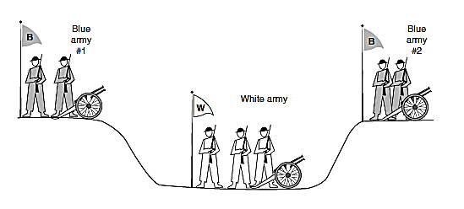
Question 4
What is the 2-army problem? Where does it occur in networking? Provide an example.
Only two blue army attack together, they can win, two blue army can only communicate through unreliable channel. Does there a protocol exist that allows the blue armies win?

Slide 30
Question 4
What is the 2-army problem? Where does it occur in networking? Provide an example.
Only two blue army attack together, they can win, two blue army can only communicate through unreliable channel. Does there a protocol exist that allows the blue armies win?
A unsolvable problem in computer science!

Slide 31
Question 4
What is the 2-army problem? Where does it occur in networking? Provide an example.
Only two blue army attack together, they can win, two blue army can only communicate through unreliable channel. Does there a protocol exist that allows the blue armies win?
A unsolvable problem in computer science!
Example: Connection release. To see the relevance of the two-army problem to releasing connections, rather than to military affairs, just substitute ‘‘disconnect’’ for ‘‘attack.’’ If neither side is prepared to disconnect until it is convinced that the other side is prepared to disconnect too, the disconnection will never happen

Slide 32
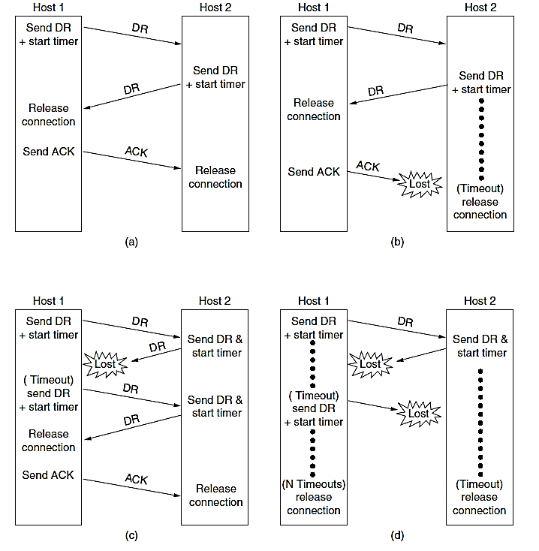
Question 3 (Connection Release)
Does the 3-way handshake-based connection release protocol create a flawless disconnection?
A: Normal case
B: Final ACK lost
C: response lost
D: response list and subsequent DRs Lost

Slide 33
Question 3 (Connection Release)
Does the 3-way handshake-based connection release protocol create a flawless disconnection?
Look at case B, If the timeout triggers while there is
data lingering in the network then the data will be lost
as connection will be terminated early (Force to disconnect). Case D as well, data lost.
They can ensure disconnection but not flawless disconnection.
Read through textbook 520
A: Normal case
B: Final ACK lost
C: response lost
D: response list and subsequent DRs Lost

Slide 34
Host1
Host2
Note: In real life, TCP release use four-way handshake as shown in the left.
The First ACK and second FIN sometimes can be put together and reduce to three-way handshake
Again, it is not a perfect protocol due to two-army problem, but the perfect solution is theoretically
impossible, and in practice, the problem rarely arise.
Refer to textbook p562
FIN
ACK
FIN
ACK

Slide 35
Transport Layer
  Transport Layer Encapsulation
  Transmission Control Protocol (TCP)
    Connection-establishment
      Three-way handshake
    Connection-release
      Asymmetric
      Symmetric
    TCP segment header
    TCP based socket
    Error-control
    Flow-control
    Congestion-control
      Slow start
      Additive increase
  User Datagram Protocol (UDP)
Application
Transport
Network
Data Link
Physical

Slide 36
Question 5 (TCP segment header)
What information is sent with the TCP Segment header, explain each field briefly?

Slide 37
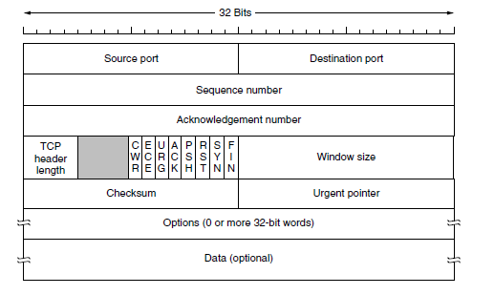
Question 5 (TCP segment header)
What information is sent with the TCP Segment header, explain each field briefly?

Slide 38
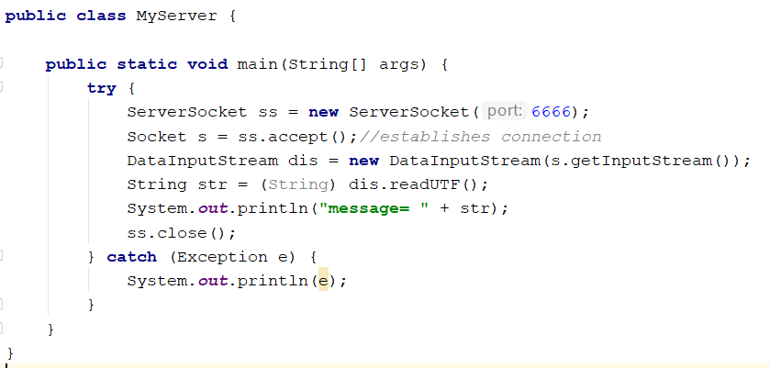
Socket connection
A socket is an endpoint in a (bidirectional) communication. TCP based socket is widely used in interconnection.
An example of socket programming in java:

Slide 39
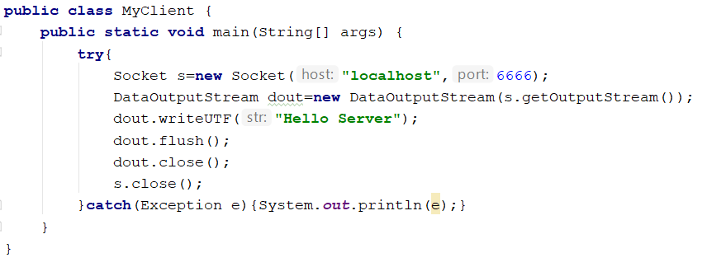

Slide 40
Question 6
Describe with a simple flowchart how a single socket-based client-server communication works.

Slide 41
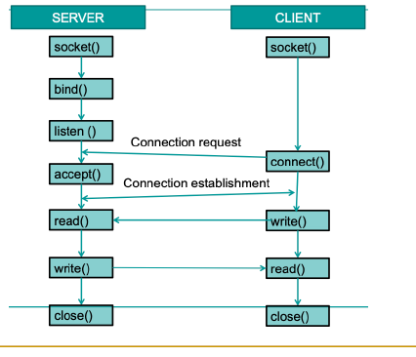
Question 6
Describe with a simple flowchart how a single socket-based client-server communication works.

